Slide 1
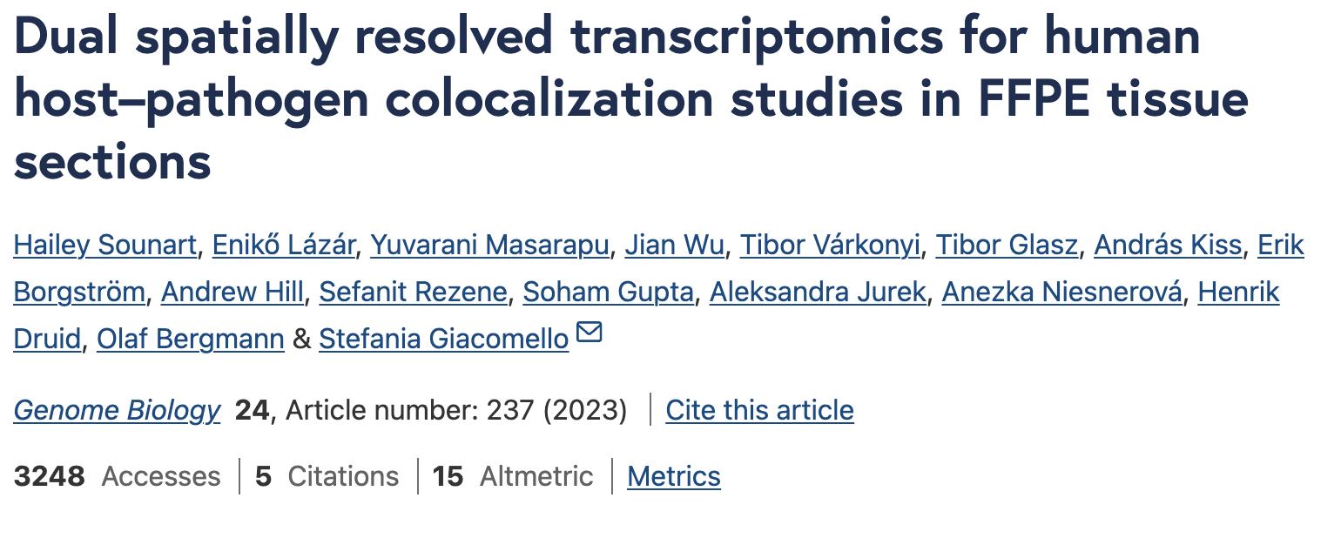
DATASET 4 - Visium Human and COVID dual

Slide 2
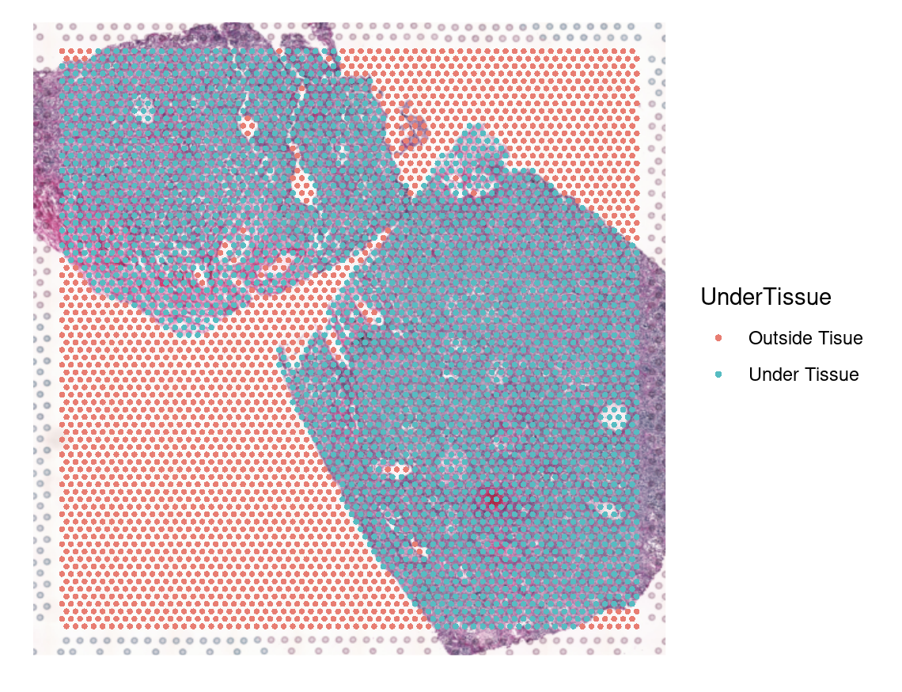
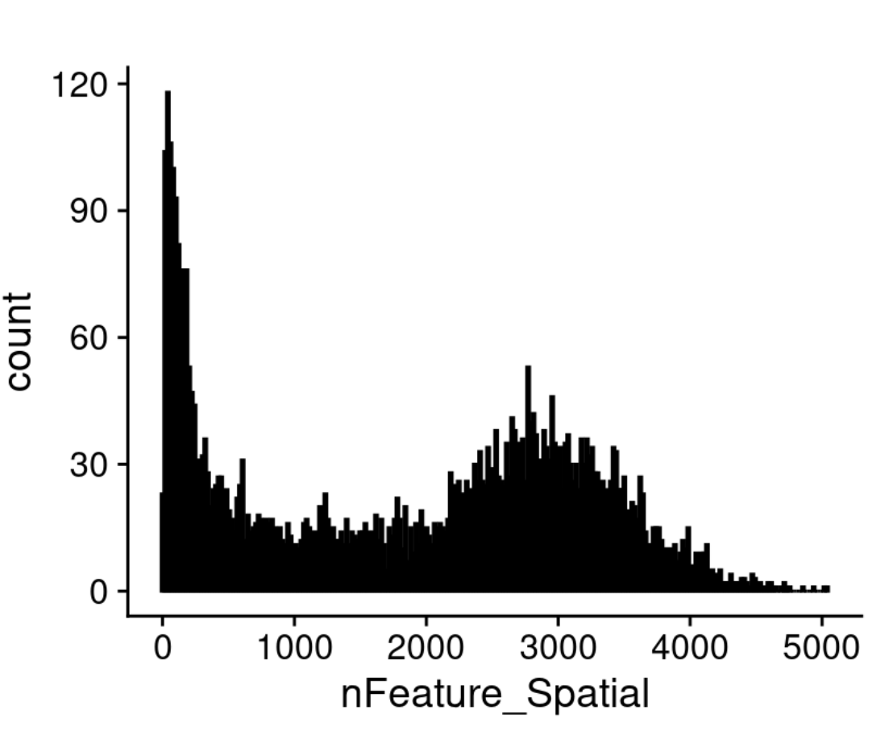
13 samples – 4 control, 4 covid (+viral probes), 5 covid (-viral probes)
1. QC
(Under tissue/Out of tissue & nFeature)

Slide 3
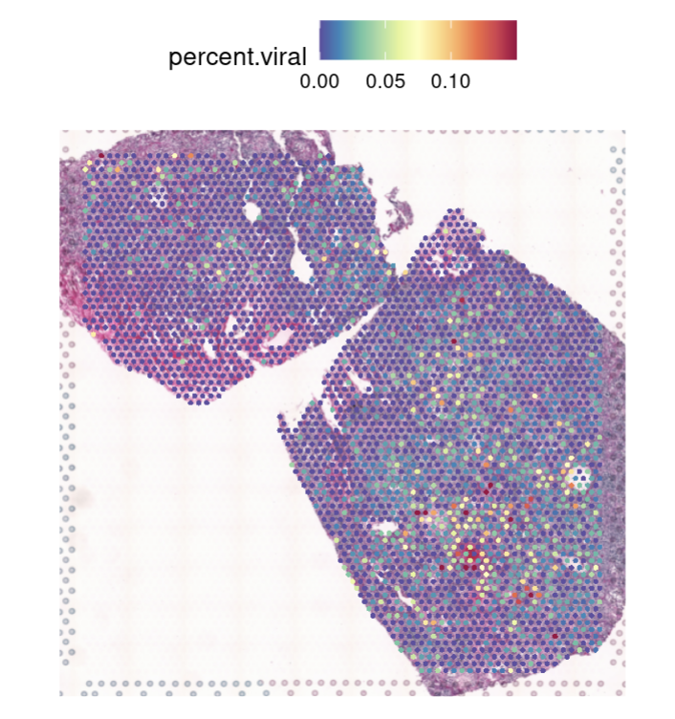
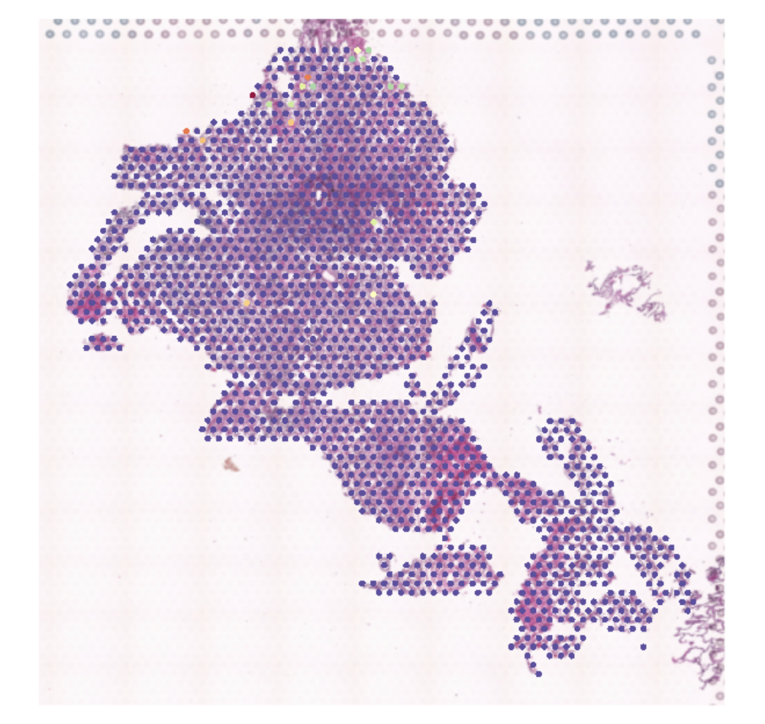
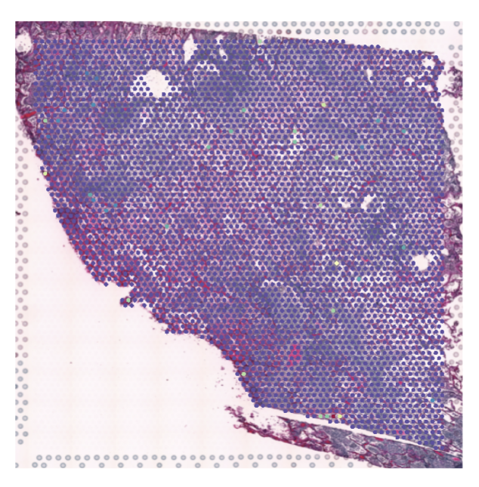
Exploring COVID expression
12 COVID genes - ORF1ab, ORF1ab.1, S, ORF3a, E, M, ORF7a, ORF7b, N, ORF8, ORF10, ORF6

Slide 4
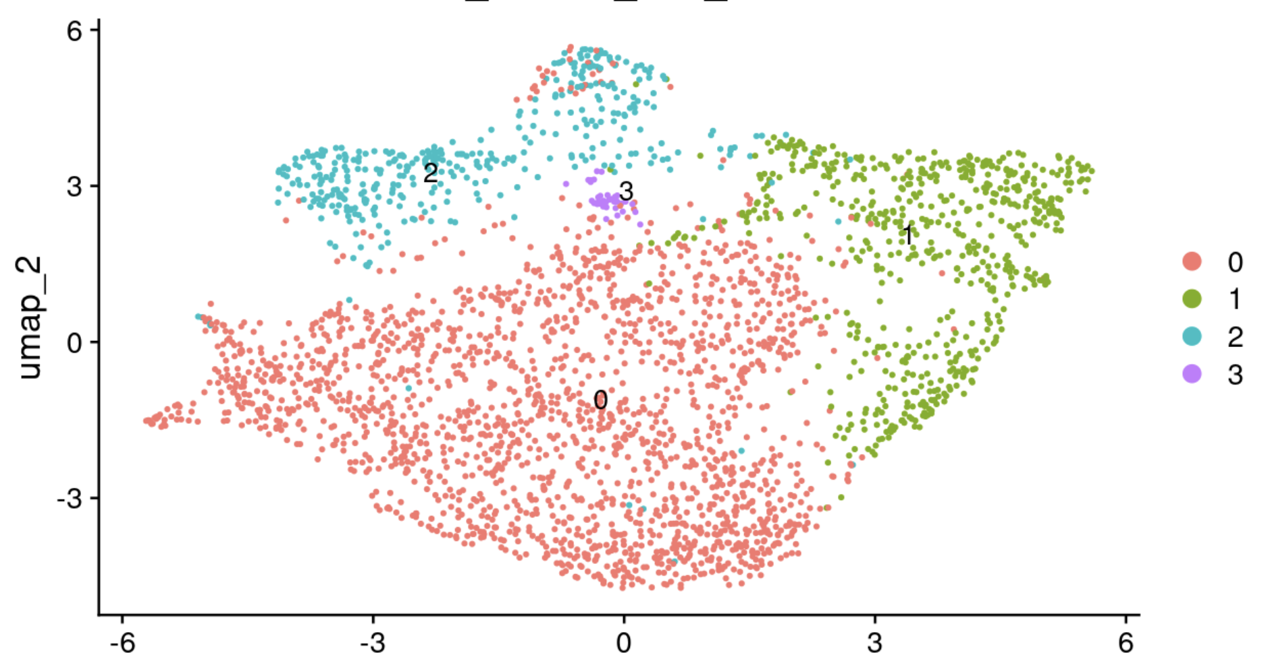
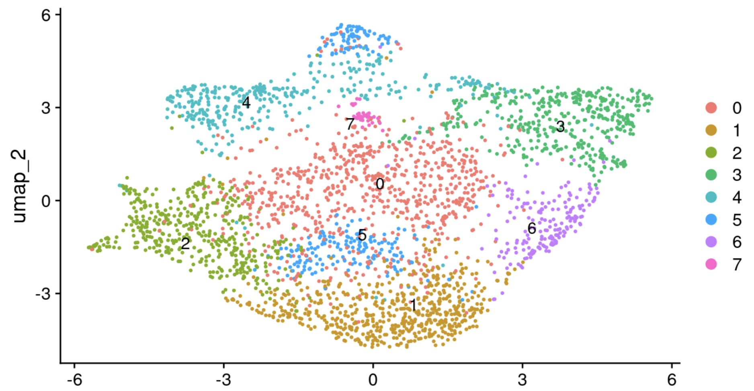
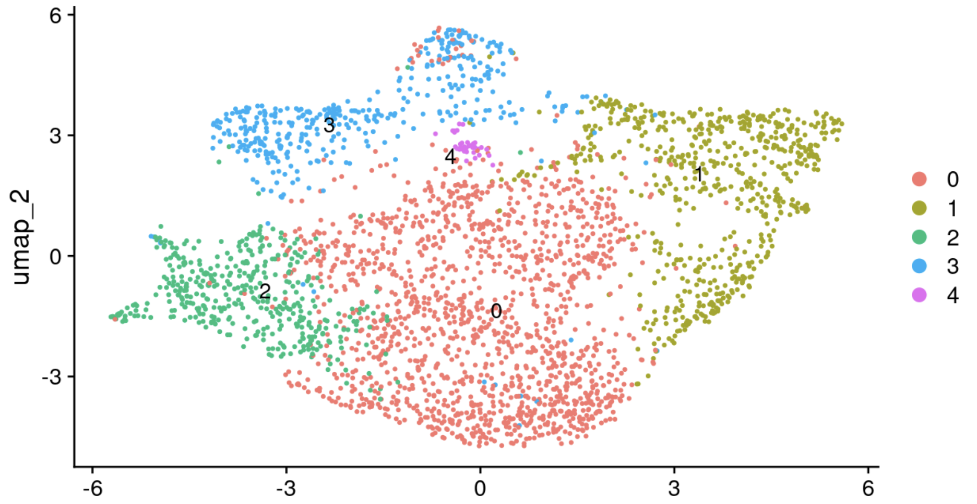
2. Subset out human only
→ Normalisation (SCTransform), PCA, clustering,
Res = 0.2
Res = 0.5
Res = 0.3

Slide 5
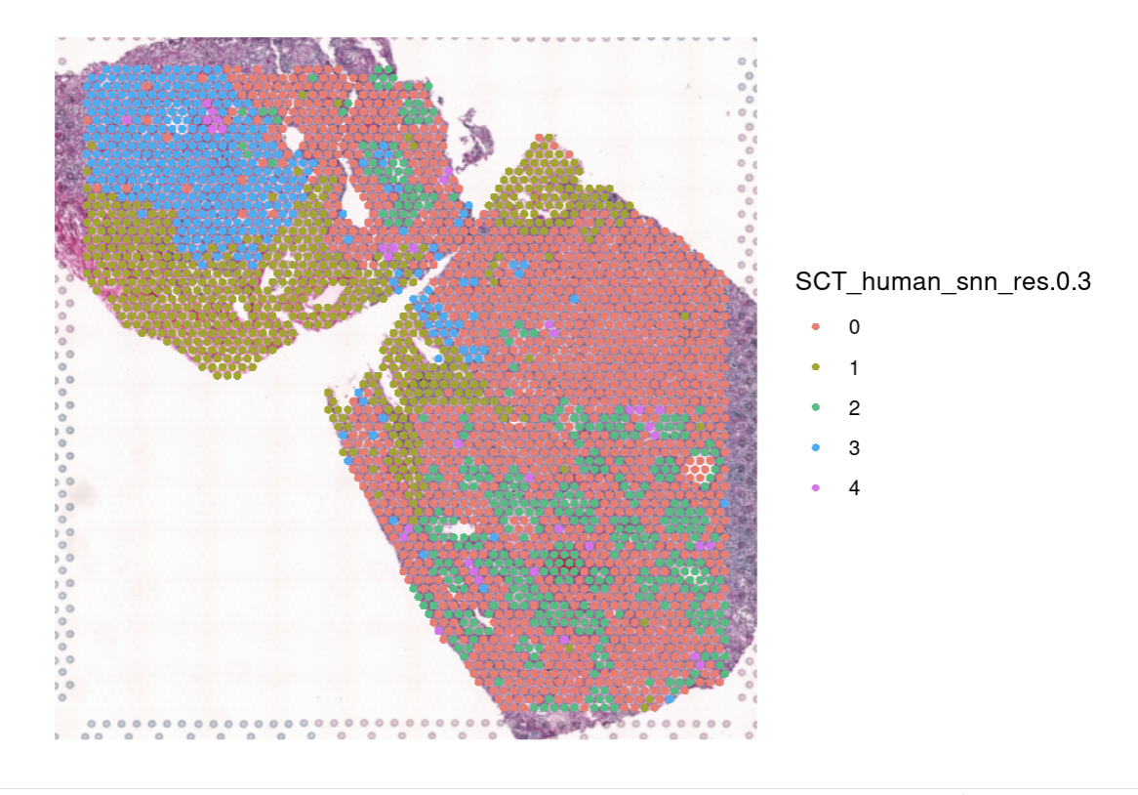
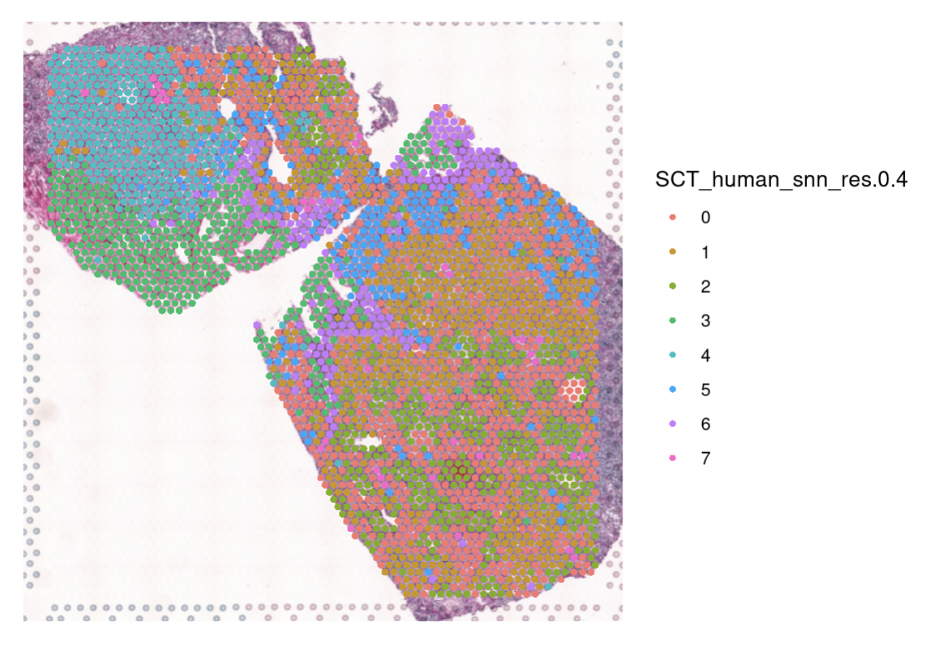
2. Subset out human only
→ Normalisation (SCTransform), PCA, clustering,

